Slide 1
Module 2 – Samples, Population, and Sampling Methods

Slide 2
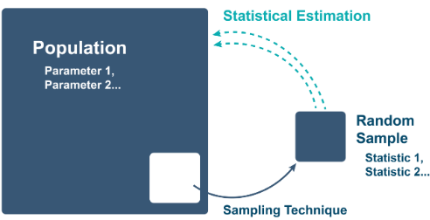

Sample vs. Population
A sample is a subset of elements from a population.
Notations:
$n$ (number of elements in a sample)
$N$: number of elements in the population
$n<N$

Slide 3
Sample vs. Population
Samples are necessary to learn about populations, because in most real-world examples, it is impossible to measure a characteristic from every member of a population.
Some examples of large populations from which it would be too difficult to measure characteristics:
The population of humans on Earth is more than 7 billion
The population of the US is more than 300 million
There are 1.8 billion bottles of Coca-Cola sold each day
There may be more than 1 million pigeons in New York City alone

Slide 4
Statistic vs. Parameter
A statistic is a numerical measure of a characteristic of a sample.
Sample mean, sample median and sample standard deviation are examples of statistics.
A parameter is a numerical measure of a population.
Data analysts analyze samples to calculate a statistic to estimate the population parameter.

Slide 5
Statistic vs. Parameter
e.g. To know the average height for all male freshmen at Northeastern University, we can randomly select 100 male freshmen to be measured.
Parameter: Average height for all the male freshmen (population) at Northeastern University
Statistic: Average height of the 100 male freshmen (sample) in the sample
Suppose the average height of the sample is 175 cm, then this sample statistic can be used to estimate the population parameter.
As with all estimates, there is uncertainty.

Slide 6
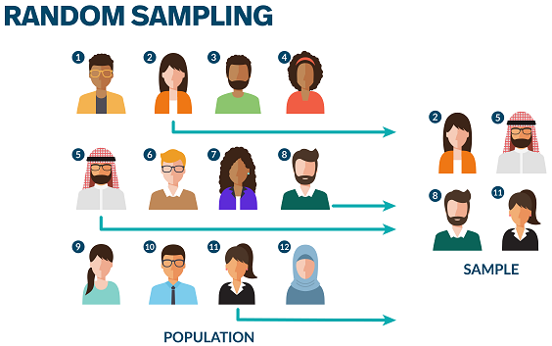

Simple Random Sample (SRS)
A simple random sample (SRS) of size $n$ consists of$N$individuals from the population chosen so every individual has an equal chance of being selected.

Slide 7
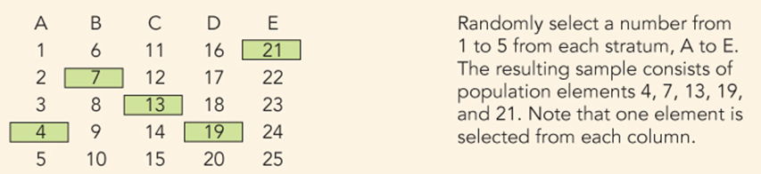
Other Sampling Methods: Stratified Sampling
Stratified random sampling divides the population into smaller subgroups known as strata.
Used when the population is organized in a hierarchy.
Step 1: The strata formed based on members' shared attributes, such as income or educational.
Step 2: Take a separate SRS in each stratum and combine these to make up the complete sample.

Slide 8
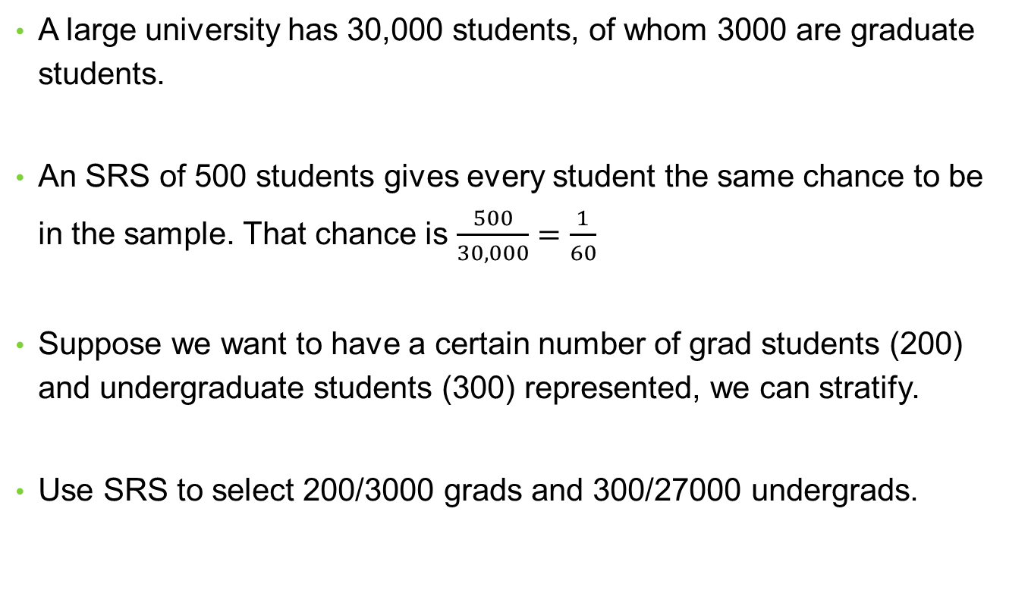
Case: Stratifying a Sample of Students
A large university has 30,000 students, of whom 3000 are graduate students.
An SRS of 500 students gives every student the same chance to be in the sample. That chance is $\frac{500}{30,000}=\frac{1}{60}$
Suppose we want to have a certain number of grad students (200) and undergraduate students (300) represented, we can stratify.
Use SRS to select 200/3000 grads and 300/27000 undergrads.

Slide 9
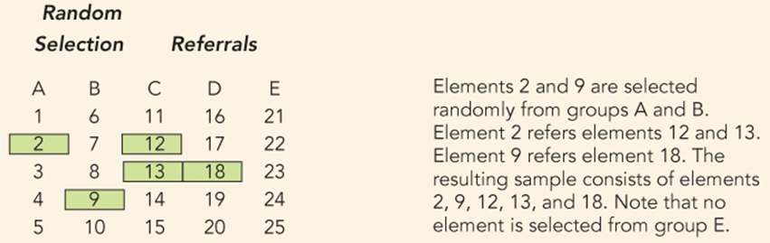
Other Sampling Methods: Snowball Sampling
An initial group of respondents is selected, usually at random.
After being interviewed, these respondents are asked to identify others who belong to the target population of interest.
Subsequent respondents are selected based on the referrals.

Slide 10
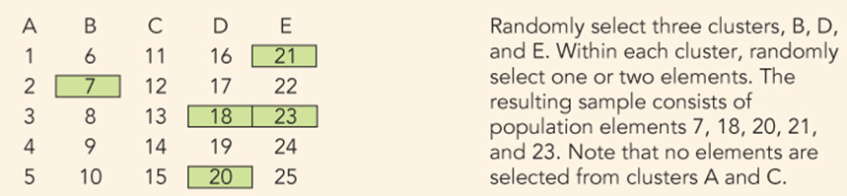
Other Sampling Methods: Cluster Sampling
The target population is first divided into subpopulations, or clusters, based on a common characteristic (e.g. geography).
Then a random sample of clusters is selected.
Then choose SRS within each cluster.
Used to sample particular clusters in a dispersed area to reduce cost.

Slide 11
Biased Sample
The design of a statistical study is biased if it systematically favors certain outcomes.
Selection of whichever individuals are easiest to reach is called convenience sampling.
A voluntary response sample chooses itself by responding to a general appeal (write-in or call-in opinion polls).
Convenience samples and voluntary response samples are often biased.

Slide 12
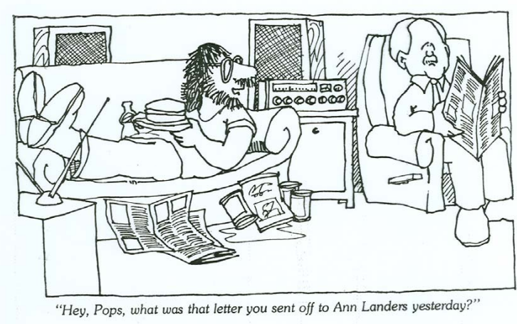
Case Study: Write-In Opinion Polls
Ann Landers, an advice columnist whose daily column was published in over 1,200 newspapers in the United States and Canada, once asked the readers of her advice column, “If you had it to do over again, would you have children?”
She received nearly 10,000 responses, almost 70% saying no.
Is it true that 70% of parents regret having children?

Slide 13
Case Study: Write-In Opinion Polls
This is an example of a voluntary response sample, in which the respondents are often those who have a strong and negative opinion.
“I believe the logical explanation for this phenomenon is (a) the hurt, angry and disenchanted tend to write more readily than the contented, and (b) people tell me things they wouldn’t dare tell anyone else.”
- Ann Landers

